Slide 1

Portugals math education
By Alice Destrait

Slide 2

Portuguese government
Goal:
critique Portugal’s math education framework
reshape the system to elevate standards nationwide
focusing remediation efforts on struggling students earlier on
Data:
from 395 students across two Portuguese schools
Objective:
find similarities between failing students and offer support early

Slide 3
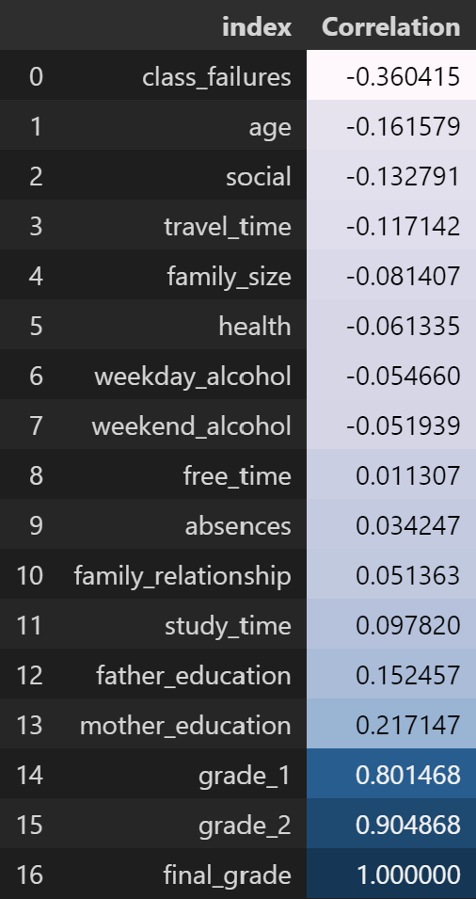
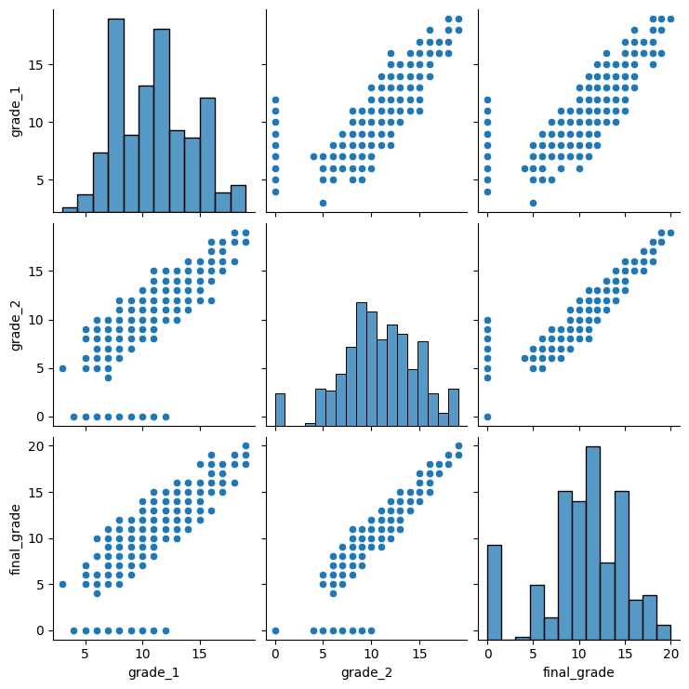
Correlations with the final grades
High positive correlation with partial grades
Grade 1 could be used as an indicator of needed support
Notes:
As there is a high positive correlation between the partial grades and the final grade, partial grade 1 is a good indicator to know if additional support is needed.

Slide 4
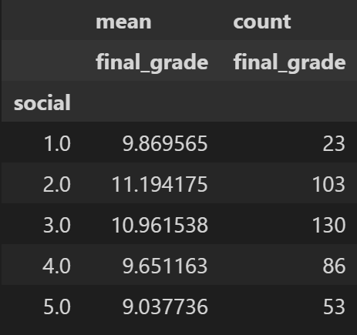
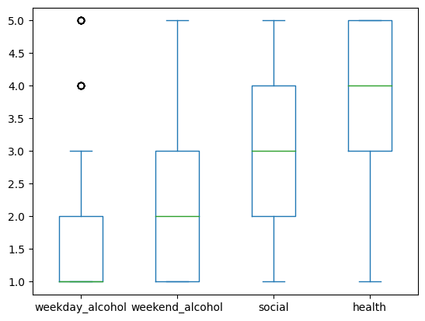
Health, Social,and Alcohol
Higher alcohol consumption than anticipated
Mostly healthy students
High and highly social is linked to lower grades
Notes:
The social aspect of students is quite concerning as half of them report a lower than average social life however having a higher than average social life is linked to having lower average final grades. Furthermore, the consumption of alcohol is higher than predicted with 25% of the students having a high or very high consumtion rate during weekends. In general, health, and alcohol consumption can not be linked to the grades of students.

Slide 5
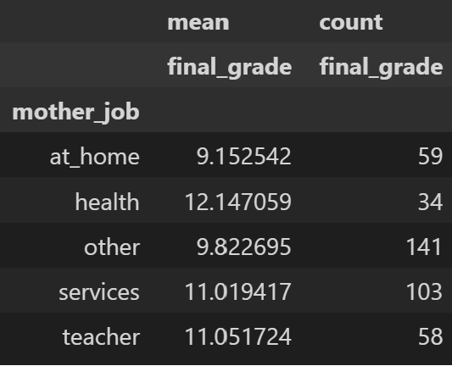
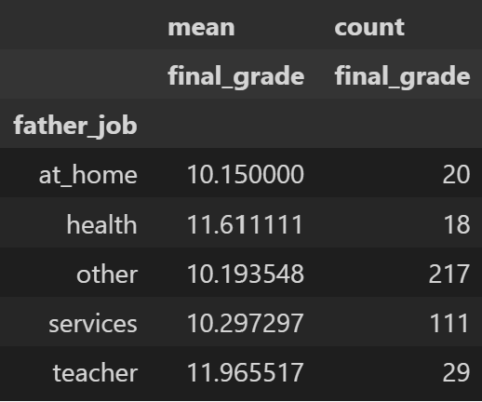
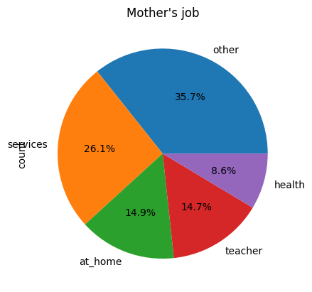
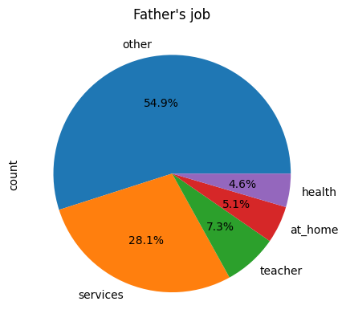
Parents’ job
Stay-at-home parents linked to lower grades
Teacher and health highest grades
Notes:
Students having a stay at home parent generally have a lower final grade with an average lower than the passing grade. Kids of teachers or health related jobs have the best average final grade.

Slide 6
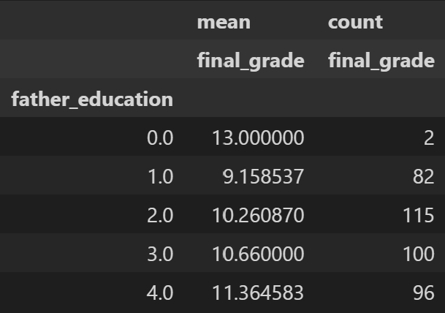
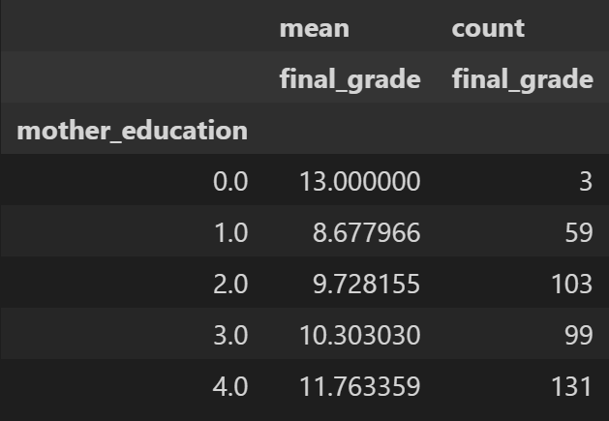
Parents’ education
Higher education, higher grades
Mother has more impact
(none:0, primary education:1, 5th to 9th grade:2, secondary education:3, higher education:4)
Notes:
The higher the education of the parents the higher the average final grade. Furthermore, the education of the mother has a higher impact on the grades of their kids.

Slide 7
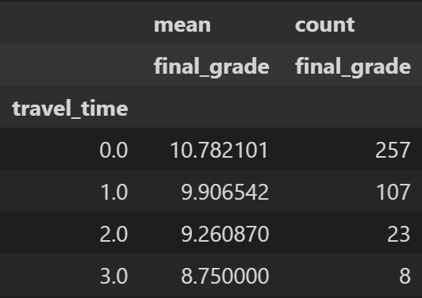
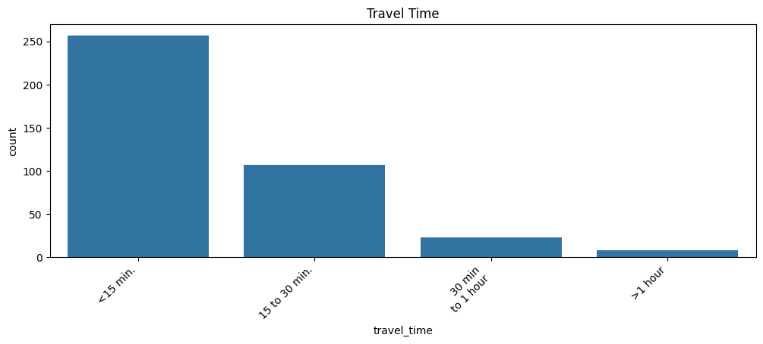
Travel time
High travel time, lower grades
Notes:
Travel time has a negative impact on the average final grade. The more students need to travel the more tired they are, the less time for studying they have, and the less free time they have.

Slide 8
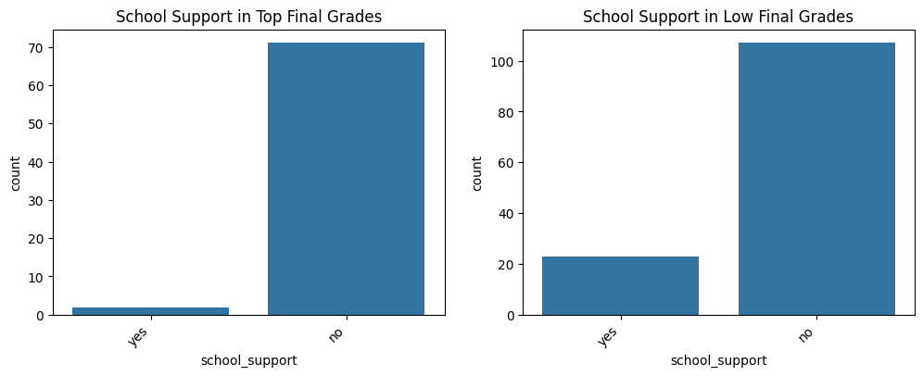
Current support
More support for failing students
High amount of failing students, no support
Notes:
The school supports a higher percentage of failing students than top students. This seems to be more in line with our goal. However there is a high amount of failing students that do not get support from their school.

Slide 9
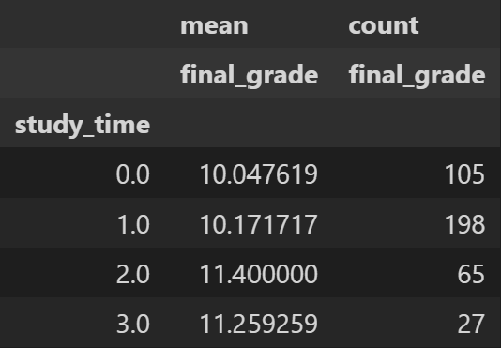
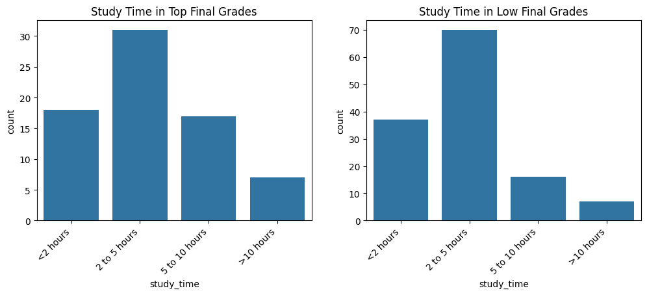
Study time
Top students: higher % study more
Best grades not for the ones that study the most
Implications: only studying more is not the solution
Notes:
Contrary to our previous believe studying more does not means having higher grades. The best average overall goes to students studying 5 to 10 hours per week. For failing students 2 to 5 hours a week seems to have the best results; For top students the highest average is obtained by those studying less than 2 hours.

Slide 10

Factors to consider
Generalization of the findings
Remediation method
Evaluation of mathematics skills at different school levels
Teaching methods

